Slide 1

Session 7 – Python Plotting with MatPlotLib

Slide 2

MatPlotLib Visuals
Overview
Basic Plotting Capabilities in MatPlotLib
Sample Plot Types
Subplots
Customization

Slide 3
Basic Plotting Capabilities in MatPlotLib
Utilize scatterplot for basics
Plot data
Plot multiple lines
Change line style
Linestyle keyword
Marker keyword
Linewidth keyword
Edit axis labels
Add text annotation
Show plot
Export plot to .pdf or other file

Slide 4
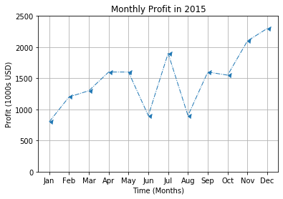
Sample Plot Types
Scatter Plot
Showing trends and patterns in data points

Slide 5
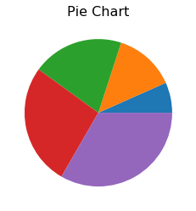
Sample Plot Types
Pie Chart
Comparing relative amounts of a whole.
More easily shows relative sizes from 100%.

Slide 6
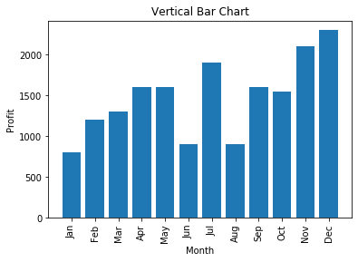
Sample Plot Types
Bar Graph
Vertical
Comparing items

Slide 7
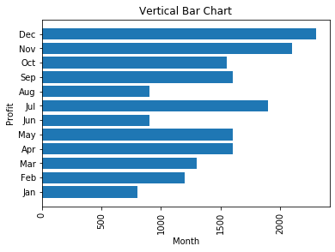
Sample Plot Types
Bar Graph
Horizontal
Comparing items where horizontal is more natural
Flashlight length
Distance travelled in a race

Slide 8
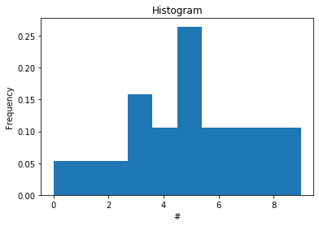
Sample Plot Types
Histogram
Plotting relative frequency of occurrences

Slide 9
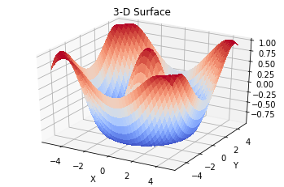
Sample Plot Types
3D
Plotting things that change based on 3 parameters

Slide 10
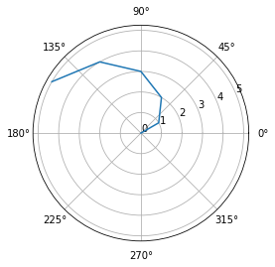
Sample Plot Types
Polar
Things circular in nature
Things that repeat on a set cycle

Slide 11
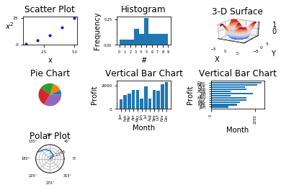
Subplots
Multiple plots on same figure

Slide 12
Customization
Can add events to plots that allow things to happen if a trigger occurs
Mouse click could change colors or scale

Slide 13
Free Data Sets
https://data.oecd.org/price/inflation-cpi.htm
https://catalog.data.gov/
https://web.archive.org/web/20060112045100/http://www.oxfordjournals.org/nar/database/c
https://github.com/awesomedata/awesome-public-datasets

Slide 14

LICENSE
Copyright 2018 Douglas Bowman
Permission is hereby granted, free of charge, to any person obtaining a copy of this software and associated documentation files (the "Software"), to deal in the Software without restriction, including without limitation the rights to use, copy, modify, merge, publish, distribute, sublicense, and/or sell copies of the Software, and to permit persons to whom the Software is furnished to do so, subject to the following conditions:
The above copyright notice and this permission notice shall be included in all copies or substantial portions of the Software.
THE SOFTWARE IS PROVIDED "AS IS", WITHOUT WARRANTY OF ANY KIND, EXPRESS OR IMPLIED, INCLUDING BUT NOT LIMITED TO THE WARRANTIES OF MERCHANTABILITY, FITNESS FOR A PARTICULAR PURPOSE AND NONINFRINGEMENT. IN NO EVENT SHALL THE AUTHORS OR COPYRIGHT HOLDERS BE LIABLE FOR ANY CLAIM, DAMAGES OR OTHER LIABILITY, WHETHER IN AN ACTION OF CONTRACT, TORT OR OTHERWISE, ARISING FROM, OUT OF OR IN CONNECTION WITH THE SOFTWARE OR THE USE OR OTHER DEALINGS IN THE SOFTWARE.

